Slide 1

All Praises and Glory be to ALLAH
Bangladesh Army University of Engineering & Technology
Welcome to the Lecture
on
Basic Mechanical Engineering Drawing
(ME 1270)
Tashin Ahmed Apon
Lecturer (Full-Time Adjunct)
Department of Mechanical Engineering
Bangladesh Army University of Engineering & Technology
RUET, Bangladesh

Slide 2
Outlines
Engineering Drawing Definition and Function
Standard
Line Types and Styles
Letters and Numbers
Scale
Paper Size
Drawing Title

Slide 3

What is Engineering Drawing?
Drawing—a graphical language that communicates ideas and information from one mind to another without the barrier of a language
A picture/drawing is worth a thousand words
Drawings are the road maps which show how to manufacture products and structures
Department of Mechanical Engineering, RUET

Slide 4
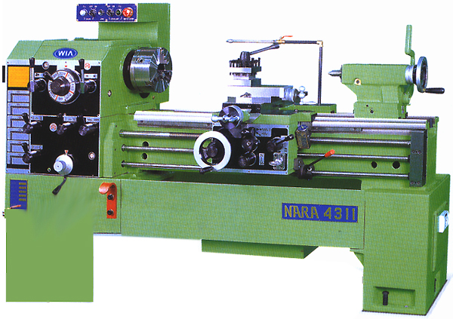
What is Engineering Drawing?
Engineering drawing – A drawing of an object that contains all information, like actual shape, accurate size, manufacturing methods, etc., required for its construction
Most especially, it communicates all needed information from the engineer who designed a part to the workers who will make it.

Slide 5



Engineering Drawing Function
Information delivery
Preservation, archiving, use of information
Ways of thinking in the preparation of information

Slide 6
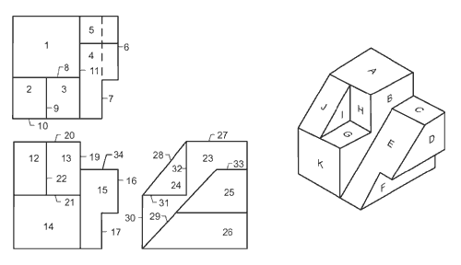
Some Examples of Engineering Drawing
Department of Mechanical Engineering, BAUET

Slide 7
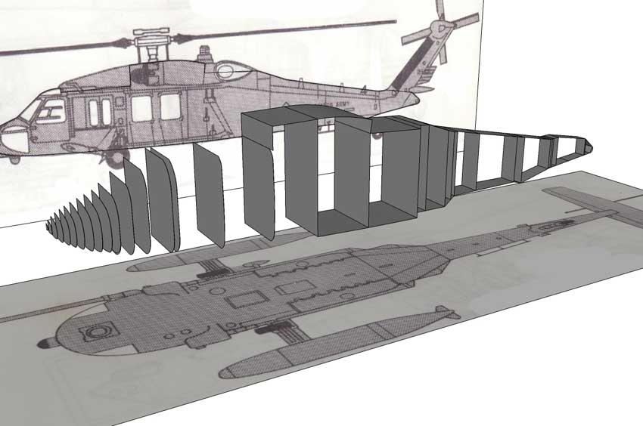
Some Examples of Engineering Drawing...
Department of Mechanical Engineering, BAUET

Slide 8
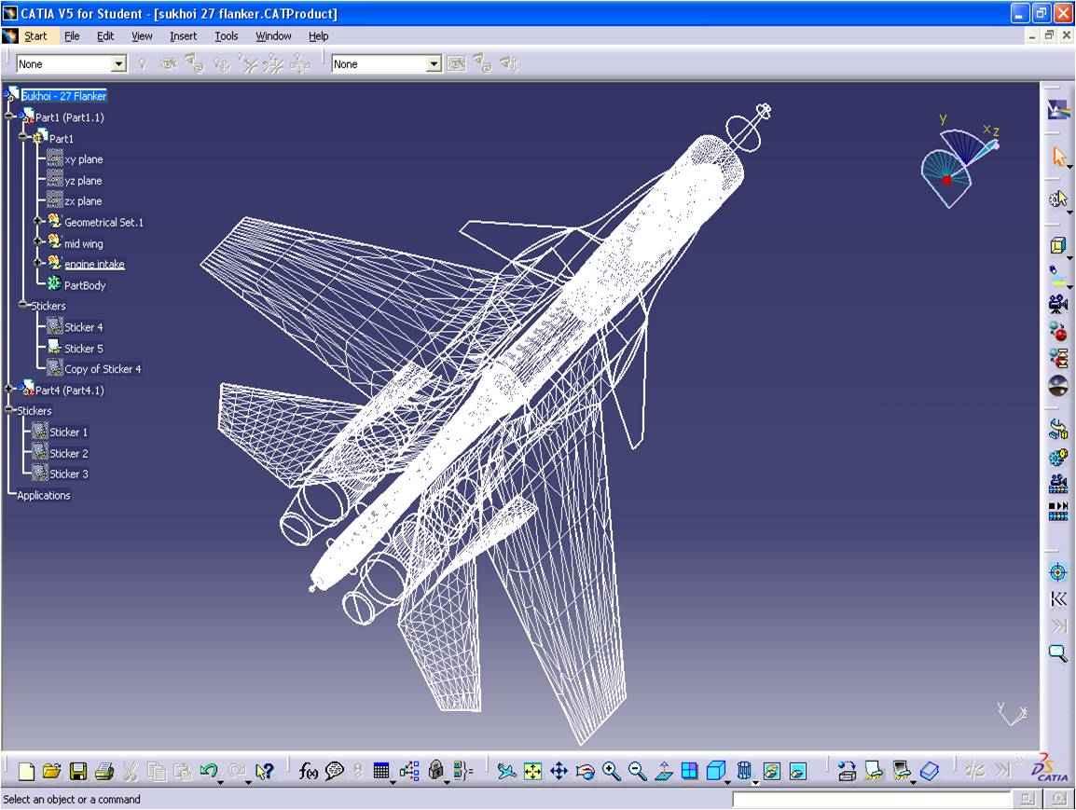
Some Examples of Engineering Drawing...
Department of Mechanical Engineering, BAUET

Slide 9
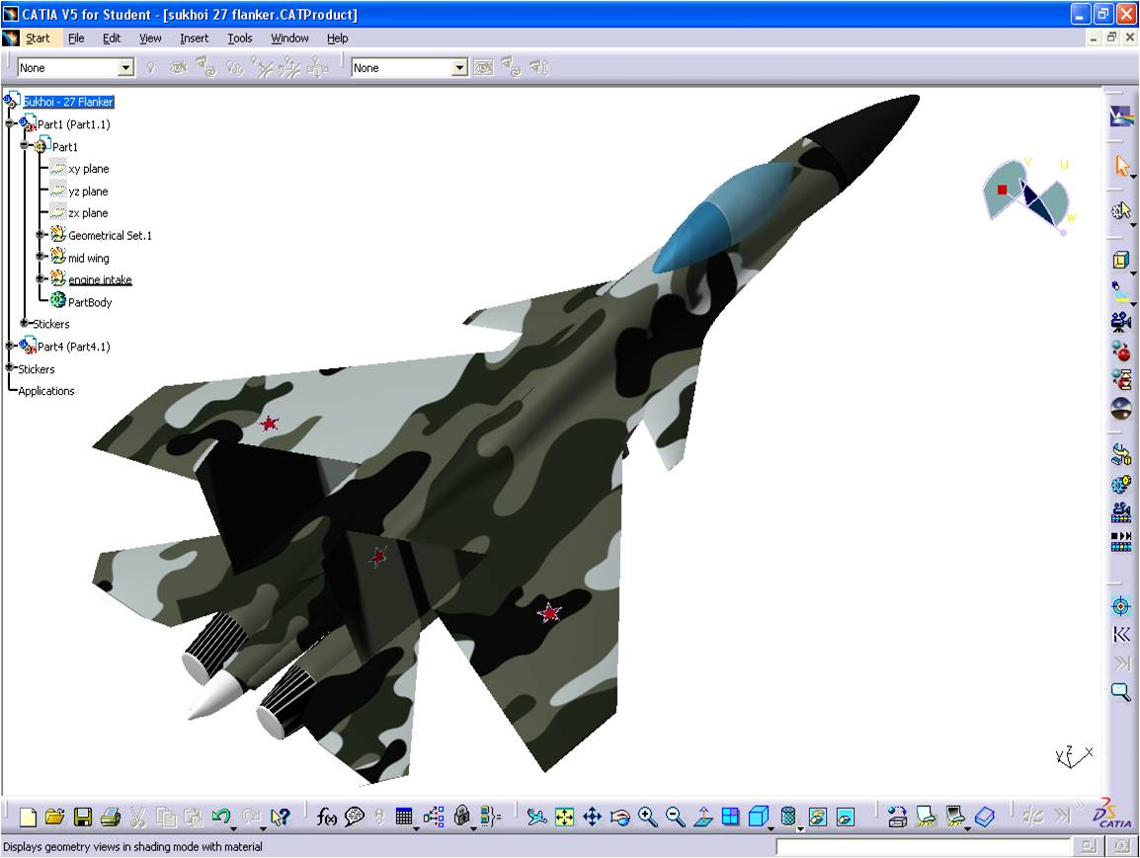
Some Examples of Engineering Drawing...
Department of Mechanical Engineering, BAUET

Slide 10
Engineering Drawing Function
Drawings convey the following critical information:
Geometry – the shape of the object; represented as views; how the object will look when it is viewed from various angles, such as front, top, side, and so on.
Dimensions – the size of the object is captured in accepted units.
Tolerances – the allowable variations from the nominal size for each dimension.
Material – represents what the item is made of.
Finish – specifies the surface quality of the item, functional or cosmetic.
Department of Mechanical Engineering, BAUET

Slide 11
Types of Drawing
Engineering drawing is completely different from artistic drawing, which are used to express aesthetic, philosophical, and abstract ideas.
Nature
Drawing
(Scenery)
Botanical
Drawing
(Flower, Plant)
Portraits
(Human Face,
expressions)
Geographical
Drawing (Maps)
Zoological
Drawing
(Creatures, animals)
Engineering
Drawings
Building Related Drawing
Machine component Drawing
Orthographic
Projection
Isometric
Projection
Department of Mechanical Engineering, BAUET

Slide 12
Types of Drawing…
Engineering Drawing
Manual Drawing
CADD
Computer has a major impact on the methods used to design and create technical drawings.
Design and drafting on computer are cheap and less time consuming.
Why we go for manual drawing?
Department of Mechanical Engineering, RUET

Slide 13
Why we go for manual drawing?
Computer cannot replace the drafting board and equipment as a learning tool
If basic fundamentals are clear, better use can be made of the power of the software
To be an expert in technical drawing, this first course on Engineering (manual) Drawing is the first step
Department of Mechanical Engineering, BAUET

Slide 14
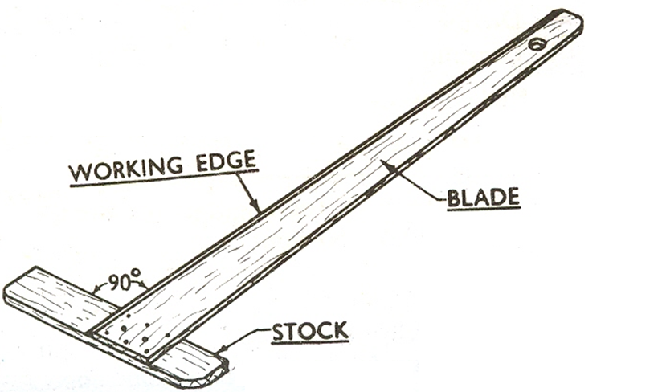
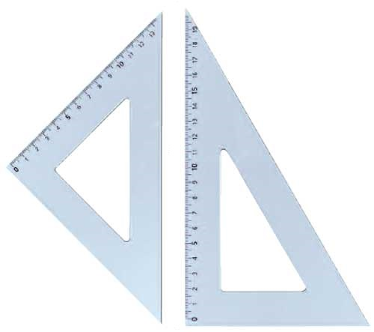
Items required for drawing
Drawing board
Drawing sheet
T- square
Instrument box containing only compass
Drawing pencils (2H and may have 4H)
Eraser
Adhesive tape
Sharpener
Duster cloth
Department of Mechanical Engineering, BAUET

Slide 15
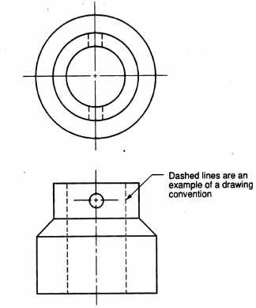
Drawing Conventions & Standards
Conventions – commonly accepted practices, rules, or methods
Dashed lines are used to represent hidden features of an
engineering drawing..
Hidden lines – location of drilled hole’s diameter, in a view where the hole cannot be directly seen.
Department of Mechanical Engineering, BAUET

Slide 16
Drawing Conventions & Standards
Standard are a set of rules that governs how technical drawings are represented
Standard are published by organizations with an interest in uniformity
ANSI – American National Standards Institute
ANSI Y14.1 1980 (R1987) – Drawing sheet size and format
ANSI Y 14.2M-1979 (R1987) – Line conventions and lettering
ANSI Y14.5M-1982(R1988) – Dimensioning and tolerances
ANSI Y 14.3-1975(R1987) – Multi view and sectional view drawings
ISO – International Standards Organization
JIS – Japanese Standards
BIS – Bureau of Indian Standards
Department of Mechanical Engineering, RUET

Slide 17
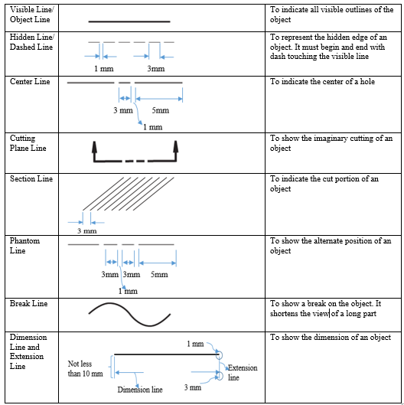
Line Types and Styles
Department of Mechanical Engineering, BAUET

Slide 18
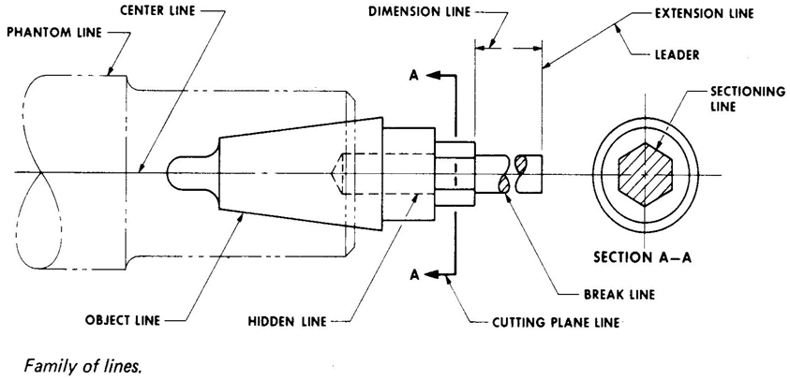
Line Types and Styles
Department of Mechanical Engineering, BAUET

Slide 19
Line Types and Styles
Department of Mechanical Engineering, BAUET

Slide 20
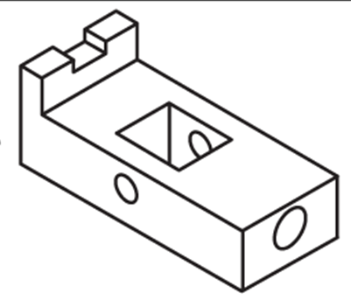

Slide 21
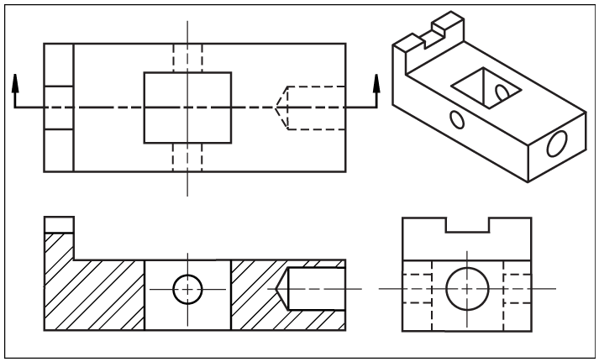
Line Types and Styles
Department of Mechanical Engineering, BAUET

Slide 22
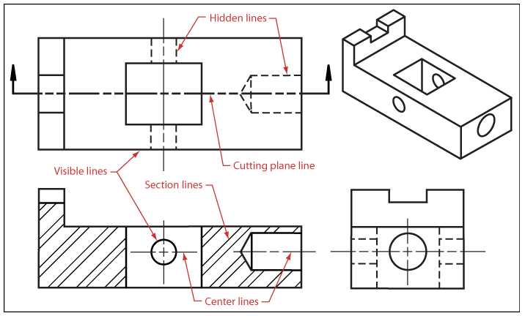
Line Types and Styles
Department of Mechanical Engineering, BAUET

Slide 23
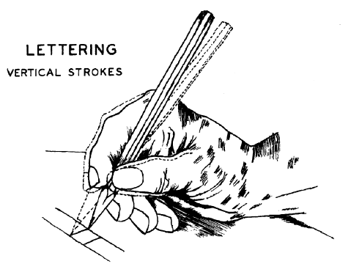
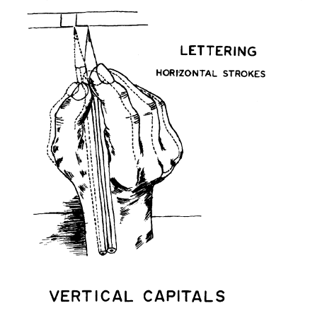
Lettering
Freehand Lettering
Developing good lettering is a personal skill which takes practice. Letters must be formed properly.
They must be open shaped very legible.
Clear communication is essential to avoid mistakes and reduce waste.
Lettering may be done using a drafting type pencil, lead holder or technical pen. Which ever tool is used, the letters must properly formed and very black
Department of Mechanical Engineering, BAUET

Slide 24
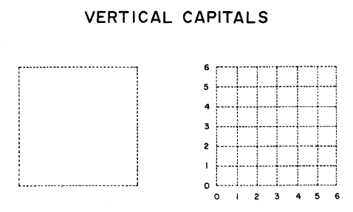
Lettering…
Vertical capital letters are preferred for most technical work. They are formed within a 6 by 6 grid.
Department of Mechanical Engineering, BAUET

Slide 25
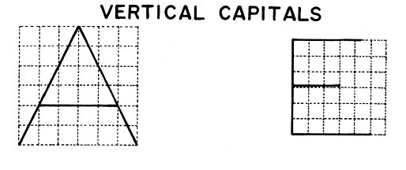
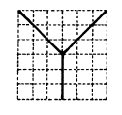


Lettering…
Most letters are slightly narrower than they are tall. The shapes of the letters are as open as possible. Letters with small loops and crossing strokes are avoided
Department of Mechanical Engineering, BAUET

Slide 26
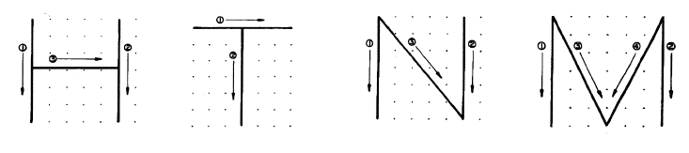
Lettering…
This sequence is recommended to assure that each letter is the correct width in relation in height. For example, form the two vertical sides of the “H”, “N” and “M” first. Form the top of the “T” first.
Department of Mechanical Engineering, BAUET

Slide 27
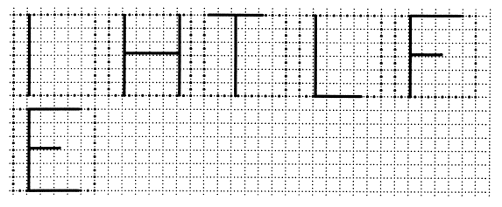
Lettering…
The “H” and “N” are slightly narrower than they are tall.
The “T” and the “M” are just as wide as they are tall
Note: Proportion: width vs. height is very important in forming letters.
Department of Mechanical Engineering, BAUET

Slide 28
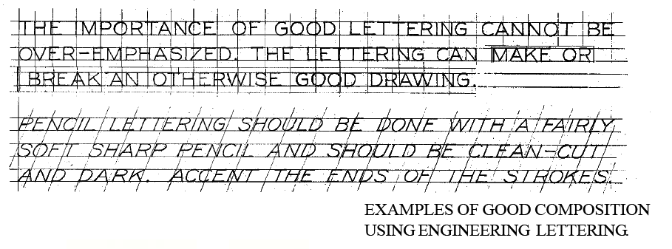
Lettering…
Single Stroke Gothic Lettering
Department of Mechanical Engineering, BAUET

Slide 29
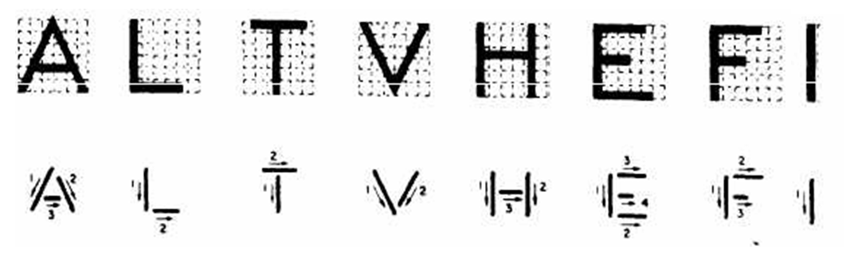
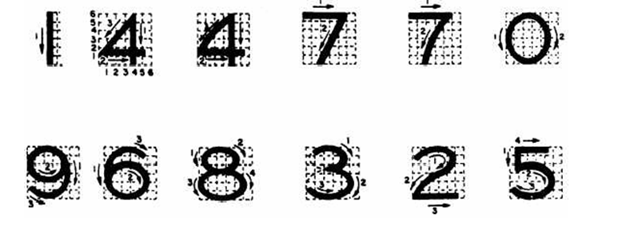
Lettering…
Lettering – Vertical Gothic Font
Department of Mechanical Engineering, BAUET

Slide 30
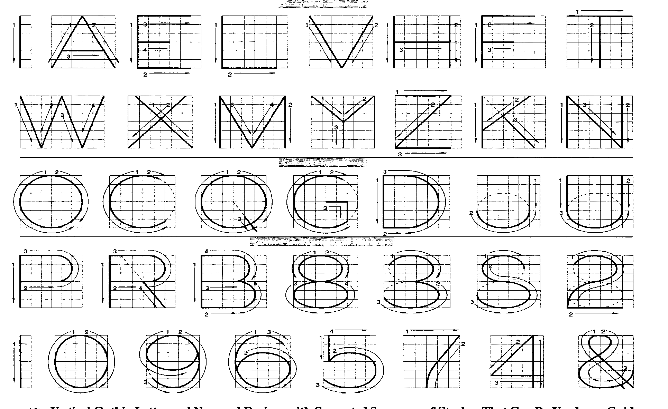
Lettering…
Lettering – Vertical Gothic Font
Department of Mechanical Engineering, BAUET

Slide 31
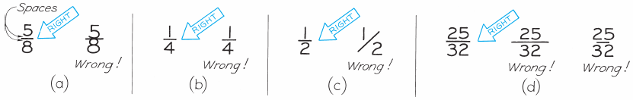
Lettering…
Lettering with Fractions
Department of Mechanical Engineering, BAUET

Slide 32
Scales
A scale is defined as the ratio of the linear dimension of the object as represented in a drawing to the actual dimensions of the same.
Scales are used to prepare drawing at:
Full size
Reduced size
Enlarged size
Department of Mechanical Engineering, BAUET

Slide 33



Layout
Drawing Sheet
$\frac{3}{4}$ inch
Border Line
1 inch
$\frac{1}{2}$inch
JOB TITLE
$$\frac{1}{8}$$
inch
TITLE BLOCK
Department of Mechanical Engineering, BAUET

Slide 34


Layout…
4 inch
NAME:
$\frac{3}{4}$ inch
ROLL:
$\frac{1}{8 }$ inch
3 inch
SECTION:
DATE: (C/D); Date
SCALE:
Department of Mechanical Engineering, BAUET

Slide 35
Question ??

Slide 36
